Slide 1

Pattern-Based Software Design
Software design often benefits from the use of established design patterns - reusable solutions to common design problems. This chapter explores the different types of patterns, how to describe and organize them, and how to apply pattern-based thinking to software design.

Slide 2
Kinds of Design Patterns
Architectural Patterns
Component-Level Patterns
User Interface Patterns
High-level patterns that describe the overall structure and organization of a software system.
Patterns that focus on the design of individual software components and their interactions.
Patterns that address common user interface design challenges and solutions.

Slide 3
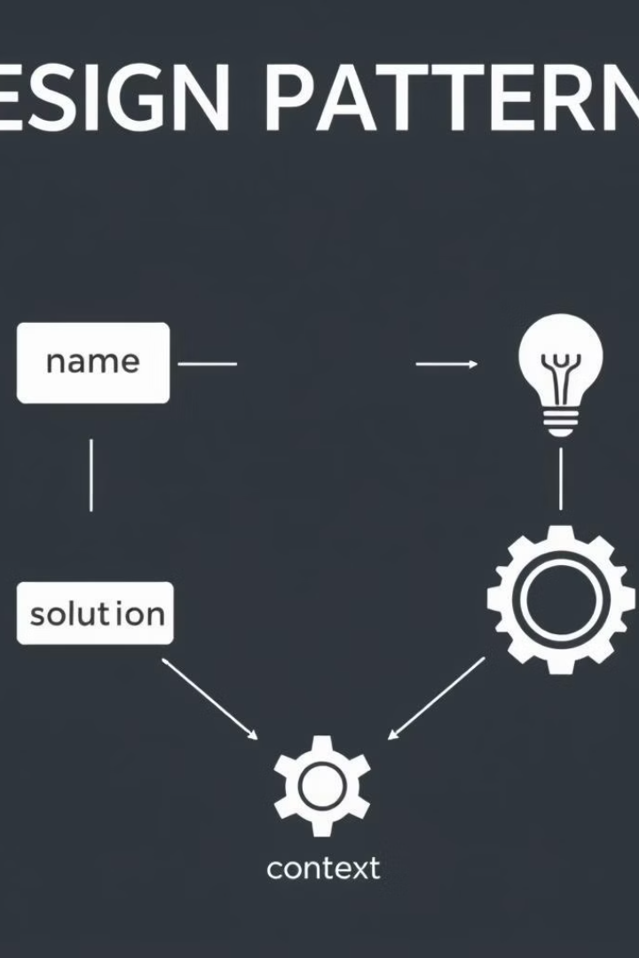
Describing Design Patterns
1
Name
A descriptive name that captures the essence of the pattern.
2
Problem
The design issue the pattern is intended to address.
3
Solution
The reusable design structure or strategy that solves the problem.
4
Context
The situations in which the pattern is applicable.

Slide 4

Pattern-Based Design Process
1
Identify Patterns
Recognize recurring design problems and match them to known patterns.
2
Organize Patterns
Maintain a catalog or table to track and cross-reference relevant patterns.
3
Apply Patterns
Incorporate the selected patterns into the overall design structure.

Slide 5
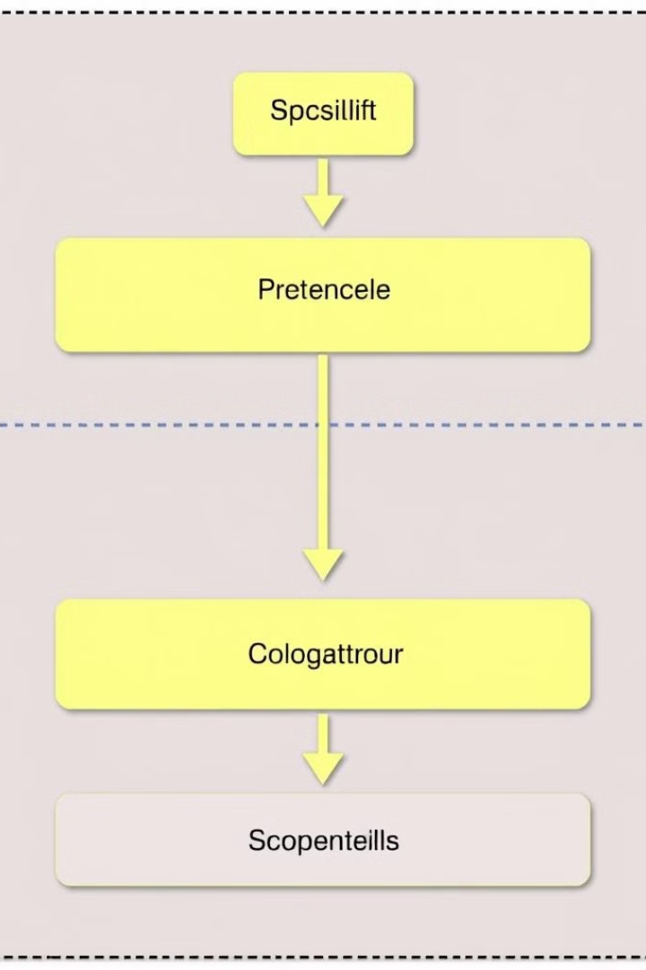
Architectural Design Patterns
Layered Architecture
Organizes the system into separate, loosely coupled layers with well-defined responsibilities.
Model-View-Controller
Separates the data model, user interface, and control logic into distinct components.
Microservices
Breaks the system into a collection of independently deployable, loosely coupled services.

Slide 6
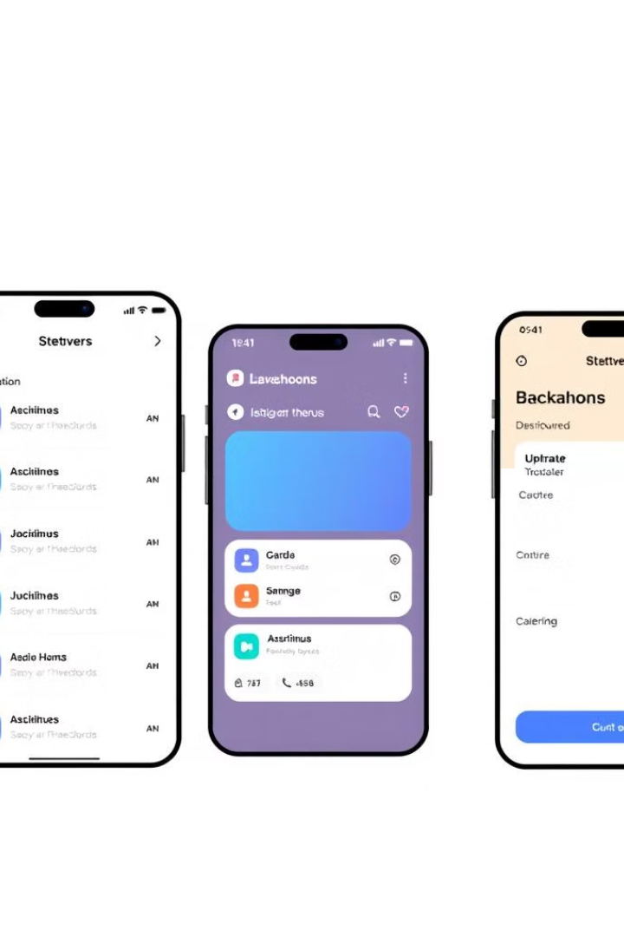



UI Design Patterns
Navigation
Patterns for organizing and presenting navigation options to users.
Forms
Patterns for designing effective and user-friendly data entry interfaces.
Cards
Patterns for displaying structured content in a compact, visually appealing way.

Slide 7
Web App Design Patterns
Design Focus
Design Granularity
Web app patterns focus on usability, responsiveness, and seamless user experiences.
Web app patterns often address both high-level architectural concerns and low-level UI elements.

Slide 8
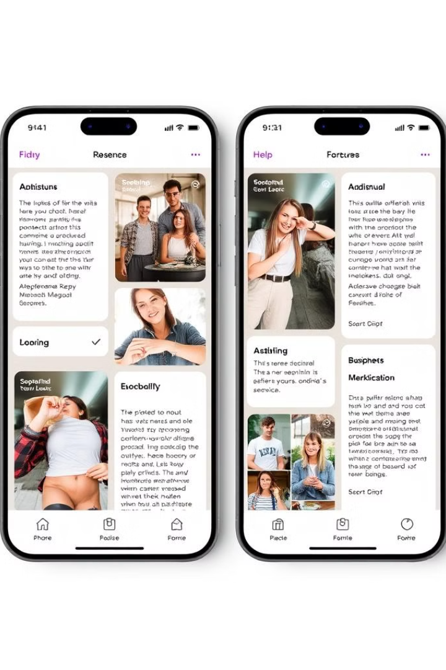



Mobile App Design Patterns
Efficiency
Mobile app patterns prioritize efficient workflows and minimizing user effort.
Context Awareness
Mobile app patterns leverage device sensors and user context to provide relevant experiences.
Adaptability
Mobile app patterns support responsive design and seamless cross-device experiences.

Slide 9

Organizing and Applying Patterns
1
Pattern Catalog
2
Pattern-Organizing Table
3
Iterative Design
Maintain a well-organized collection of relevant design patterns for easy reference.
Apply patterns flexibly and iteratively, adapting them to the specific design needs.
Create a table to track and cross-reference patterns by type, problem, and context.

